Slide 1
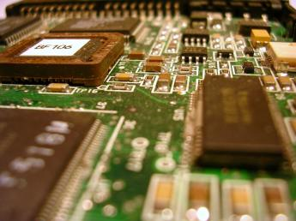
COE3062
Microcontrollers & Embedded Systems
Department of Computer Engineering
General Sir John Kotelawala Defence University.

Slide 2
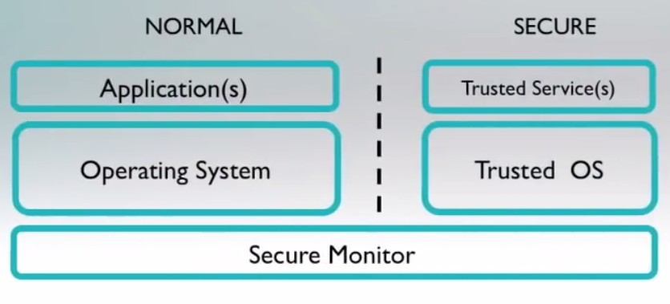
Microcontrollers - ARM Programmer's Model
Security Extensions - Trust Zone
  Two virtual machines on same hardware
  Provides two worlds “secure” and “normal”
  Monitor acts as gatekeeper for moving between two worlds

Slide 3
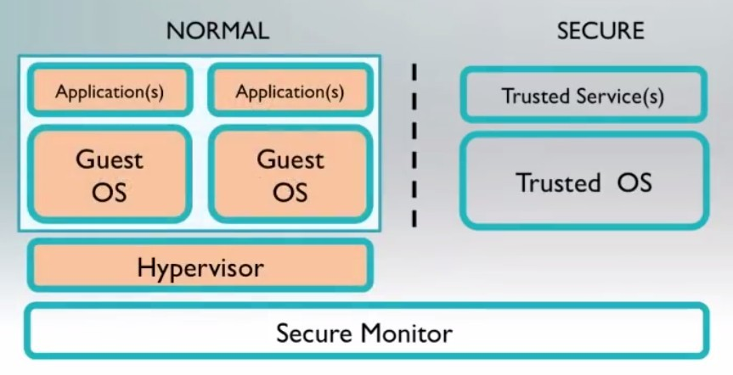
Microcontrollers - ARM Programmer's Model
Virtualization Extensions
  Hypervisor

Slide 4
Microcontrollers - ARM Programmer's Model
Instruction set
  Classes of instructions
    Data Processing
    Branch Instructions
    Load-store Instructions
    Software interrupt Instructions
    Program status register instructions

Slide 5
Microcontrollers - ARM Programmer's Model
Data processing instructions
  Consist of :
Arithmetic: ADD ADC SUB SBC RSB RSC Logical: AND ORR EOR BIC Comparisons: CMP CMN TST TEQ
Data movement: MOV MVN
These instructions only work on registers, NOT memory
Syntax: <Operation>{<cond>}{S} Rd, Rn, Operand2
Comparisons set flags only - they do not specify Rd Data movement does not specify Rn
Second operand is sent to the ALU via barrel shifter.

Slide 6
Microcontrollers - ARM Programmer's Model
Ex:
ADD r1,r2,r3
Implements r1 = r2 +r3
ADD r2,r3,r3,LSL #2
Implements: r2 = r3 + (r3 * 4)
ANDS r4,r4,#0x20
Implements: r4 = r4 & 0x20
By default, data processing instructions do not affect the condition code flags but the flags can be optionally set by using “S”. “CMP” does not need “S”
LDR r0, [r1]
Implements: r0 = *r1

Slide 7
Microcontrollers - ARM Programmer's Model
Load/Store instruction set - No direct manipulation of memory
LDR r0, [r1]
Implements: r0 = *r1
●
Pre and post indexing
Pre-index with write back: LDR r0,[r1,#4]
  Update the address base register with new address
○
Post index: LDR r0,[r1],#4
Update the address register after address is used

Slide 8
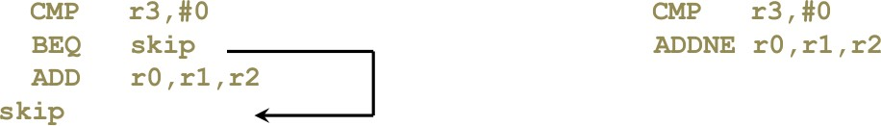
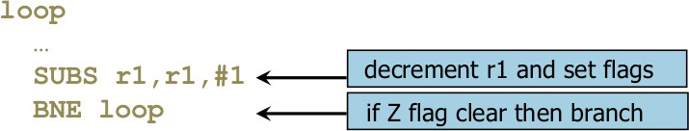
Microcontrollers - ARM Programmer's Model
Instruction set
  Conditional execution - ARM instructions can be made to execute conditionally by postfixing them with the appropriate condition code field.
    This improves code density and performance by reducing the number of forward branch instructions.

Slide 9
Microcontrollers - ARM Programmer's Model
Store with conditional
STRNEB r2, [r3,r4]
Implements:
If (NE) *(r3+r4) = r2

Slide 10
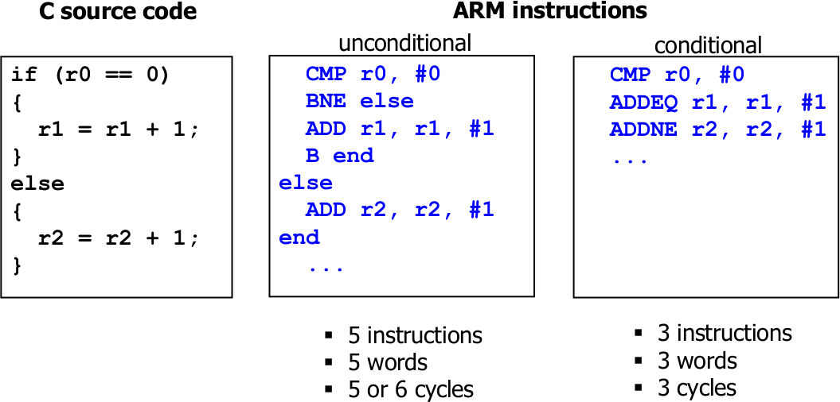
Microcontrollers - ARM Programmer's Model
Conditional execution

Slide 11
Microcontrollers - ARM Programmer's Model
Thumb Instructions - 16bit
○
○
○
High code density
Thumb-2 allows mixing with ARM (mixed length)
Very good with compilers (ARM more convenient in direct assembly programming)
●
Vector Floating Point (VFP) instructions
Requires VFP co-processor or software support libraries
●
NEON
○
○
○
Neon is a wide SIMD data processing architecture Intended for media applications (codecs etc ..)
Can code in assembly or C compilers or OpenMAX libraries

Slide 12
Microcontroller Interfacing Technologies
The communication strategies we have explored so far (shared buses) are most commonly found in SoCs
For multi-chip / multi-board systems, the communication needs can be different:
○
○
○
Performance is not (necessarily) a significant factor Simplicity in terms of hardware and wiring (cost) Configurability, expandability
●
Some Serial Communication standards in use
RS-232 (UART)
SPI
I2C
CAN
One-wire
USB

Slide 13
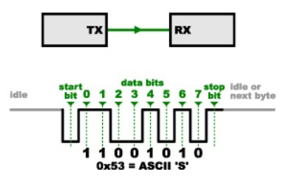
Communication Technologies
RS-232 (Universal Asynchronous Receiver/Transmitter - UART)
RS-232 is a widely-used standard for serial communication between two devices over a short distance. It is best known for its use in older PC serial ports, but it is also used in embedded systems as a debug port or for linking two devices.
Commonly known as asynchronous communication
○
■
■
■
■
No control over the data is sending. Both Tx and Rx is running at same rate. use Start and Stop bit for synchronizing. Same transmission speed in both side

Slide 14
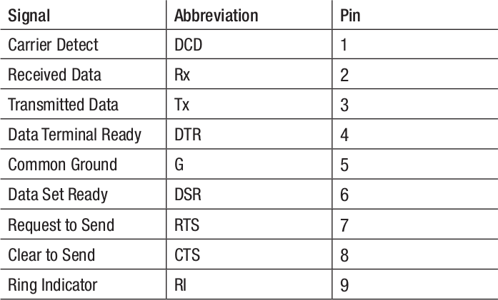
Communication Technologies
RS-232 (UART)
  Devices often implement RS-232 using a universal asynchronous receiver/transmitter (UART). The UART uses a shift register to convert a byte of data into a serial stream, and vice versa. In embedded designs, UARTs can also communicate directly without the use of RS-232 transceivers.
  The RS-232 standard specifies numerous signals, many of which are not commonly used. The two most important signals are Transmitted Data (Tx) and Received Data (Rx).

Slide 15
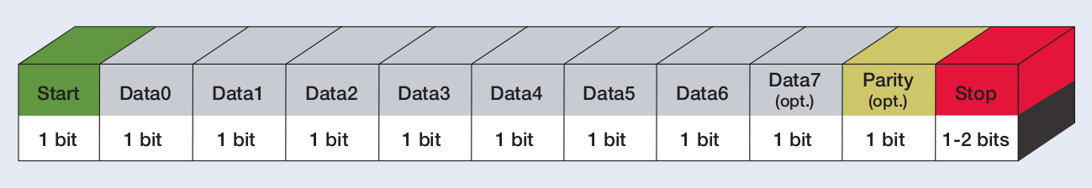
Communication Technologies
RS-232 (UART)
Start - The byte begins with a start bit. Data - Several bits of data follow. Parity - An optional parity bit.
Stop - 1, 1.5, or 2 stop bits.
An RS-232 bus does not have a clock line. Each device uses its own clock to determine when to sample the data lines. In many designs, a UART uses the rising edges of the Tx and Rx signals to synchronize its clock with the other device’s clock.
○

Slide 16
Communication Technologies
Serial Peripheral Interface (SPI) Bus
Originally developed by Motorola in the late 1980s for their 68000 series micro-controllers.
SPI is primarily used between microcontrollers and their immediate peripheral devices.
The SPI bus is a master/slave, 4-wire serial communications bus. The four signals are clock (SCLK), master output/slave input (MOSI), master input/slave output (MISO), and slave select (SS).
Whenever two devices communicate, one is referred to as the "master" and the other as the “slave”.
The master drives the serial clock. Data is simultaneously transmitted and received, making it a full-duplex protocol.
○
○
○
○

Slide 17
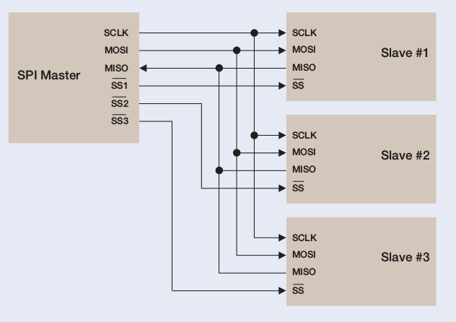
Communication Technologies
Serial Peripheral Interface (SPI) Bus
  Common SPI configuration

Slide 18
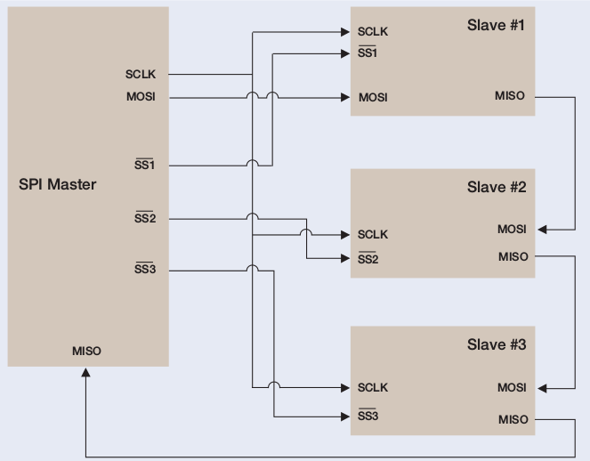
Communication Technologies
Serial Peripheral Interface (SPI) Bus
  Daisy chained SPI configuration

Slide 19
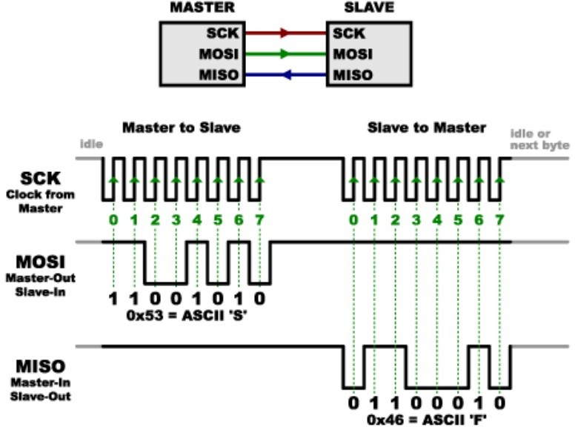
Communication Technologies
Serial Peripheral Interface (SPI) Bus

Slide 20
Communication Technologies
Serial Peripheral Interface (SPI) Bus
  Pros
■
■
■
■
Fast for point-to-point connections
Easily allows streaming/constant data inflow
No addressing in protocol, so it’s simple to implement Broadly supported
○
Cons
■
■
■
■
Slave select/chip select makes multiple slaves more complex No acknowledgement (can’t tell if clocking in garbage)
No inherent arbitration
No flow control (must know slave speed)

Slide 21
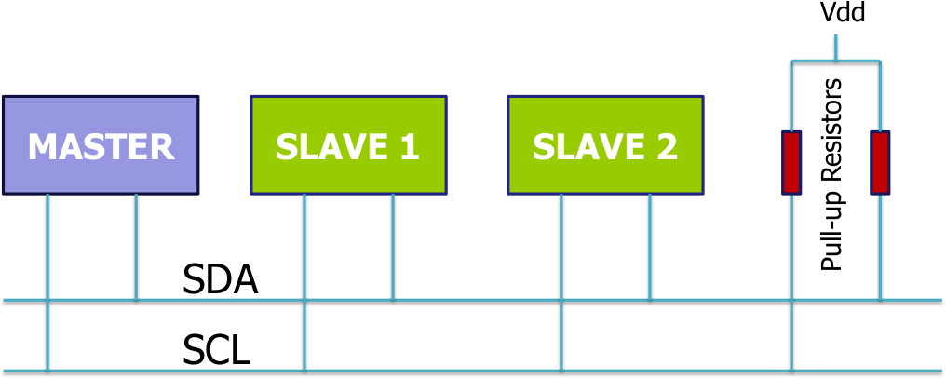
Communication Technologies
Inter - Integrated Circuit (I2C) Bus
It was originally developed by Philips in the early 1980s to provide a low-cost way of connecting controllers to peripheral chips in TV sets. The simple two-wire design has found its way into a wide variety of chips like I/O, A/Ds, D/As, temperature sensors, microcontrollers and microprocessors from numerous leading chipmakers.
Two-wire interface is comprised of bi-directional serial clock (SCL) and data (SDA) lines.
○
○

Slide 22
Communication Technologies
Inter - Integrated Circuit (I2C) Bus
Any I2C device can be attached to the bus allowing any master device to exchange information with a slave device.
Each device is recognized by a unique address. A device can operate as either a transmitter or a receiver, depending on its function. Initially, I2C only used 7-bit addresses, but evolved to allow 10-bit addressing as well.
Three bit rates are supported: 100 kb/s (standard mode),400 kb/s (fast mode), and 3.4 Mb/s (high-speed mode).
The maximum number of devices is determined by a maximum capacitance of 400 pF or roughly 20-30 devices.
SDA (data line) is bidirectional,communication is half duplex SDA, SCL are open-drain, require external pullup resistors
– Allows multiple bus masters
○
○
○
○
○

Slide 23
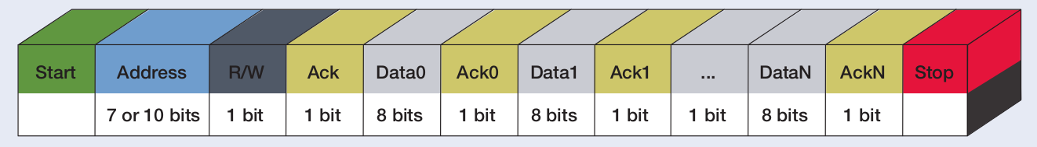
Communication Technologies
Inter - Integrated Circuit (I2C) Bus
○
○
Start - indicates the device is taking control of the bus and that a message will follow. Address - a 7 or 10 bit number representing the address of the device that will either be read from or written to.
R/W Bit - one bit indicating if the data will be read from or written to the device.
Ack - one bit from the slave device acknowledging the master’s actions. Usually each address and data byte has an acknowledge, but not always.
Data - an integer number of bytes read from or written to the device.
Stop - indicates the message is complete and the master has released the bus.
○
○

Slide 24
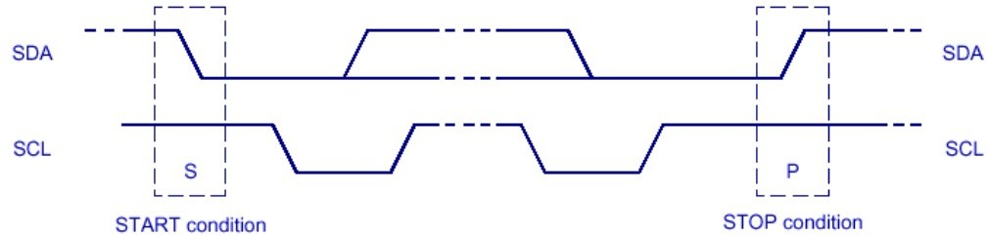
Communication Technologies
Inter - Integrated Circuit (I2C) Bus
  START condition: Signals begin of transfer (occupies the bus)
    A HIGH to LOW transition on the SDA line while the SCL is HIGH
  STOP condition: Signals end of transfer (releases the bus)
    A LOW to HIGH transition on the SDA line while the SCL is HIGH
○
○
Both these are always generated by the Master Repeated START condition is allowed
Repeated start is used for changing the slave, or changing the direction of data transfer (Send/Receive) for the same slave

Slide 25
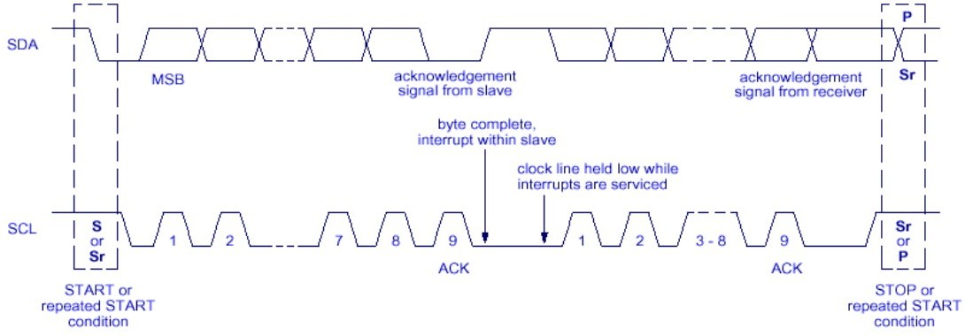
Communication Technologies
Inter - Integrated Circuit (I2C) Bus - Data Transfer
○
○
○
○
Every byte on the SDA line must be 8-bits long
Each byte must be followed by an acknowledgement from the receiver Data byte is transferred bit-wise with the MSB as the first bit sent
A slave can force the master to wait by holding the clock line SCL LOW

Slide 26
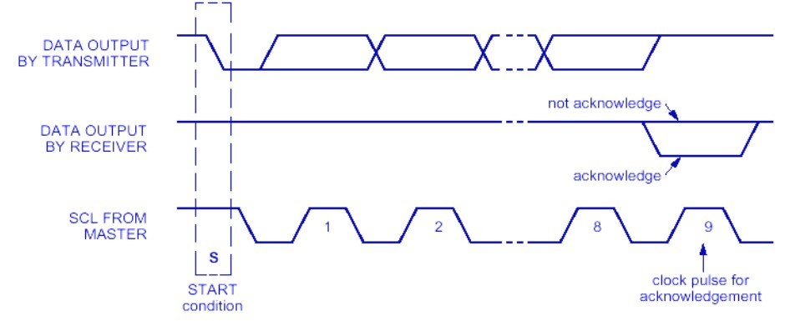
Communication Technologies
Inter - Integrated Circuit (I2C) Bus - Acknowledgement
○
○
The acknowledge-related clock-pulse is generated by the master The transmitter (master or slave) releases the SDA line i.e.SDA is HIGH for the ACK clock pulse
The receiver must pull-down the SDA line during the acknowledge clock pulse (stable LOW) during the HIGH period of the clock pulse
○

Slide 27
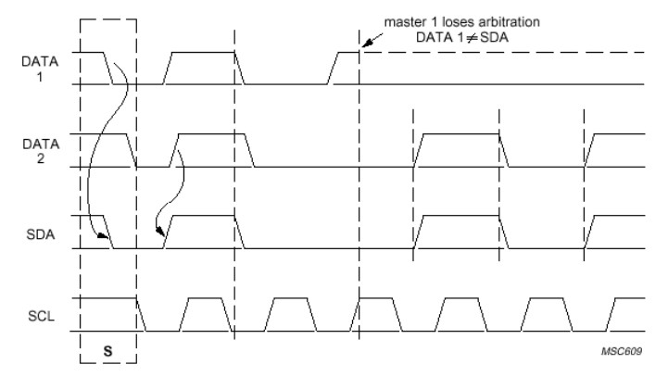
Communication Technologies
Inter - Integrated Circuit (I2C) Bus - Arbitration
If more than one device is capable of being a master, then an arbitration mechanism is needed to choose the master that takes control of the bus
Arbitration takes place on the SDA, while the SCL is at the HIGH line
○
The master which transmits a HIGH level,
Another master is transmitting LOW level will switch off its DATA output stage because the level on the bus does not correspond to its own level

Slide 28
Communication Technologies
Inter - Integrated Circuit (I2C) Bus - Summary
○
○
○
The pin (and connection) requirements are the least complex in I2C The noise immunity is higher for I2C
There is a feedback to the transmitter (Ack signal) for conveying the success of the transfer
Note: I 2 C now has higher speed modes of operation (~5 Mbit/s)
○

